Slide 1
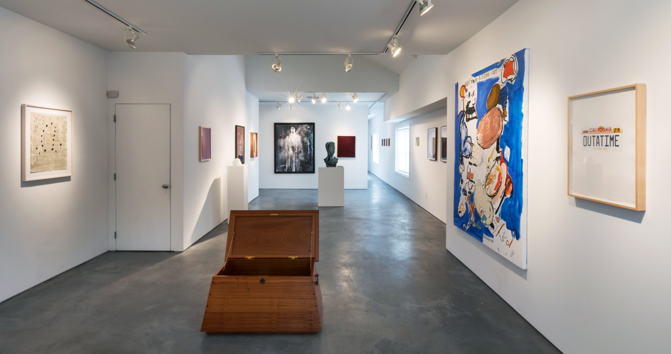
LocalArt
Coupon Effectiveness Analysis
Based on T-test method
Xudong ZHANG
Nov 28 2017
Notes:
Project given by professor

Slide 2
Background
An artwork dealer makes revenue from commission
Paintings 8%, Jewelry 8%, Mosaics 12%, Sculpture 12%
A Debate between two co-founders
Whether 10%-off coupon will improve revenues (commission)
T-test (normality, equal variance)
Notes:
Background.
So a t-test is needed to rest this debate
One of the most common tests in statistics is the t-test, used to determine whether the means of two groups are equal to each other. The assumption for the test is that both groups are sampled from normal distributions with equal variances.

Slide 3
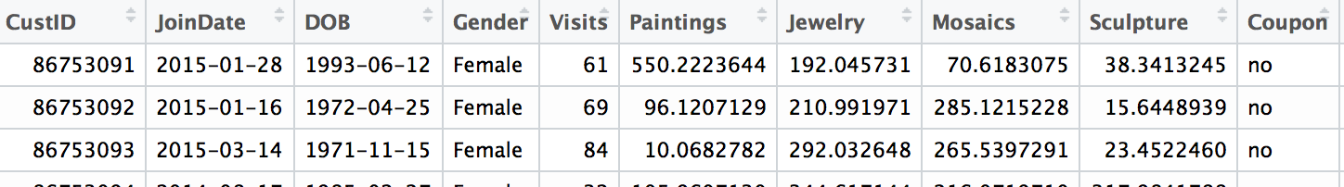
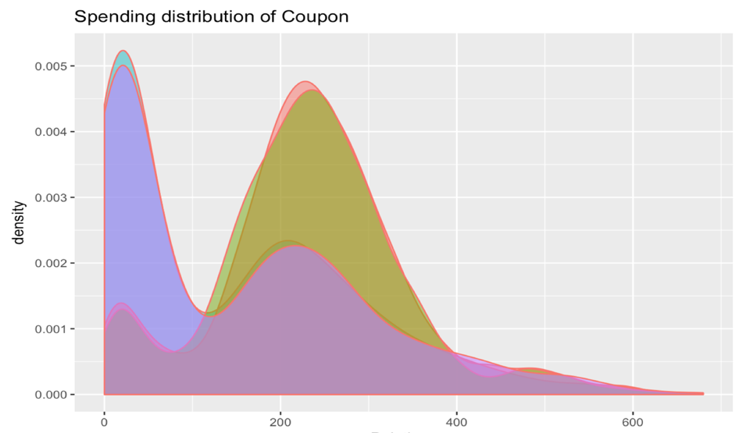
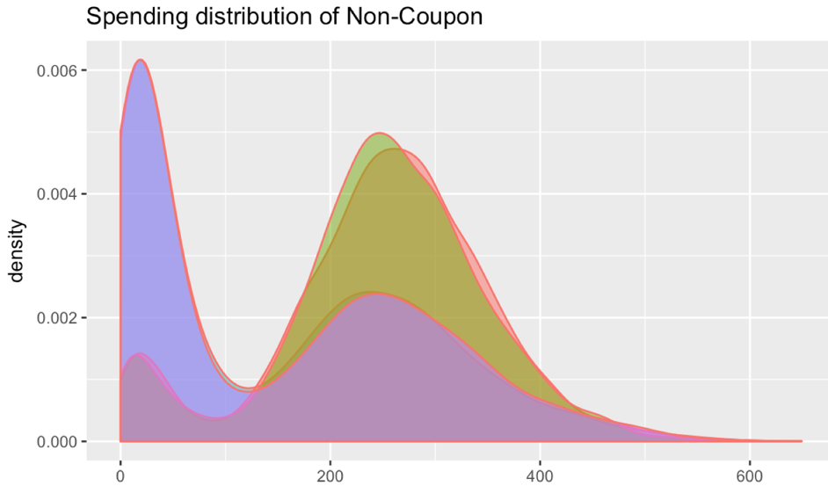
Data preview
T-test assumption:
Normality
Equal variance
Notes:
T-test: One of the most common tests in statistics, used to determine whether the means of two groups are equal to each other. The assumption for the test is that both groups are sampled from normal distributions with equal variances.
Here I plot the Density distribution of four items spending
（not technically normally distributed, but as instructed in the documentation）
This might be the most vulnerable part of this analysis. And I hope professor could leave some comments on this later on
From this preview of data,
-- this does not tell many things.
--To Dig deeper, to segment the customer and examine the corresponding coupon effects on each segment

Slide 4
Methodology
Demographics Recognition
Age, Joindate, Visit frequency per month
Customer segmentation
T-test
Coupon vs Non-Coupon
Nested t.test function
Filtering
Significance level(α)
Segmenting Analysis and Visualization
One dimension
Multi-dimension
Notes:
Here is the methodology

Slide 5
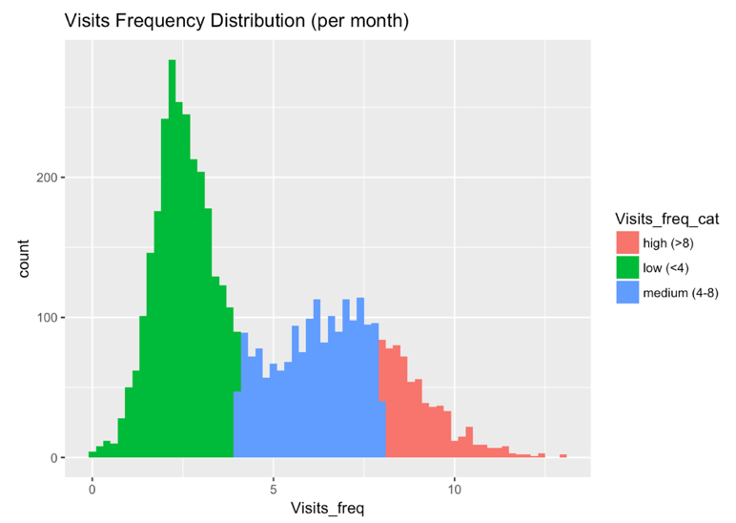
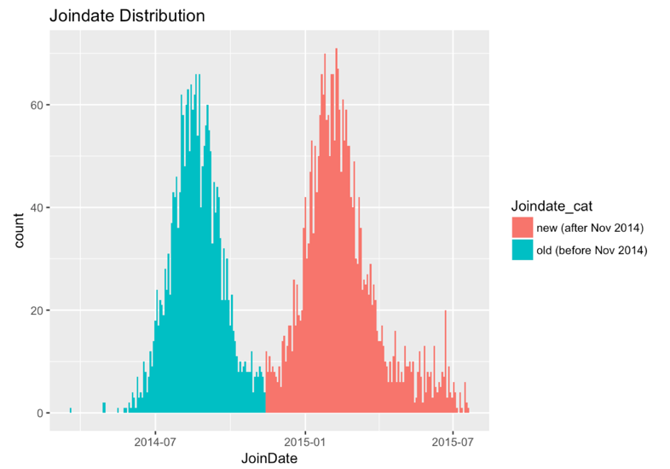
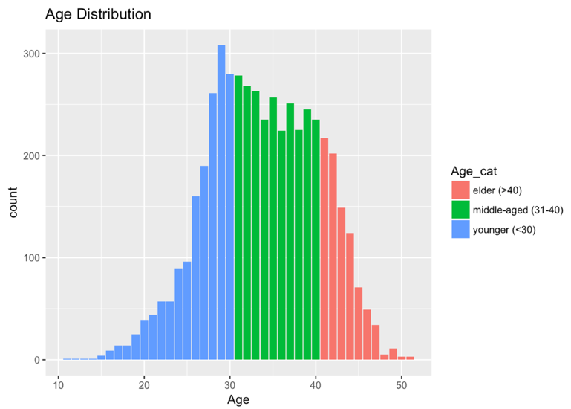
Data preparation
3 * 3 *2 = 18 customer segments
Notes:
Clear bimodal distribution. Intuitively segment
The way of categorizing (If statistically correct)

Slide 6
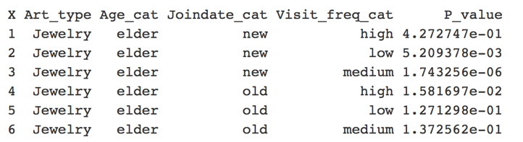
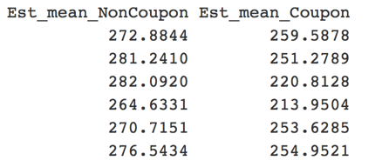
Data preparation
> head() of 4* 18 = 72 pairs of t-test result
Item (4)
Customer segmenting (3*3*2)
To filter(<.01)
T-test x & y (difference)
> dim(data)
[1] 72 7
> filter(…)
> dim(…)
[1] 49 7
Significance level: α = 1%
Filtering: Ignore those 23 statistically insignificant case
Notes:
Based on the above 18 segmentations and the 4 types of spending, we got 72 (4*3*3*2 = 72) subgroups of customer spending and got 72 pair of t-test results. Then I get a new dataset like this.
the data contains not only the characteristics (like age, joindate, etc.) of this customer segment, but also the t-test results (like p-value and the mean of t-test). Based on these data, we implemented the following analysis to check the coupon effects on the spending of these customers (significant or insignificant, positive or negative)
Set the significance level to be 1%, we can get 49 remaining t-test that represent significant coupon effects on customer spending

Slide 7
Data Analysis
Before commission
Spending level
To test
customer purchasing power
coupon sensitivity
aesthetics
Notes:
Before we dive into the final revenue, we can analyze at a single item spending level.
In this way, we can test…

Slide 8
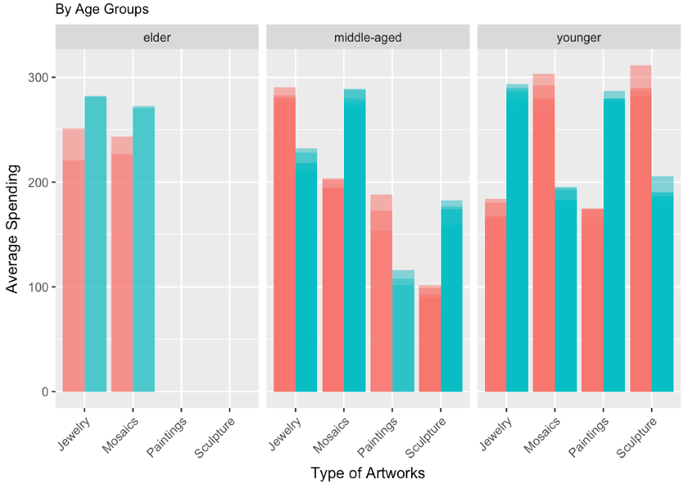
Data analysis
One dimension
See elder group
Missing values and insignificant effects
See younger group
Largest gaps and volatility

Slide 9
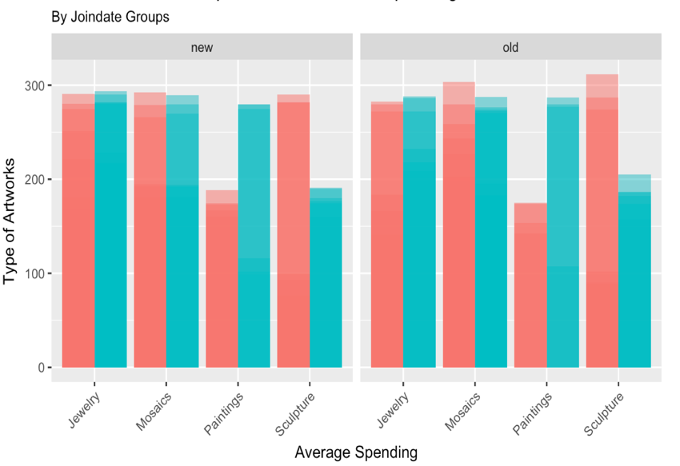
Data analysis
One dimension
Reversed coupon effects
On paintings and sculpture
Notes:
Change the dimension to joindate category, no much difference between new and old users.
But we can see

Slide 10
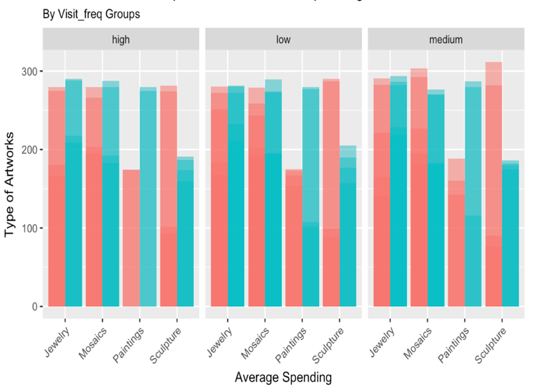
Data analysis
One dimension
Similar reasoning

Slide 11
Data Analysis
Two dimension
Reversed coupon effects
On younger and middle-aged group
Notes:
Go to two-dimensional, visualiza more precisely.
Magically reversed effects on young and middle-aged
Simply check which bar is taller
Spend more effort to design a smart coupon plan

Slide 12
Data Analysis
Commission level
To find guidelines for future coupon promotions
To maximize revenue
Notes:
Its time to go deeper to see the effects on the commission
To help to maximize revenue

Slide 13
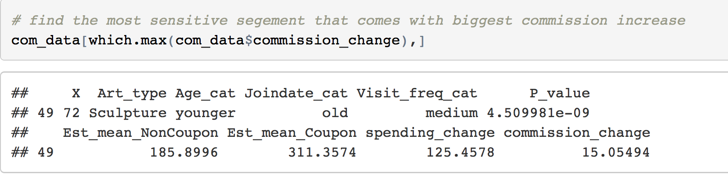
Data Analysis
Most contributing group and item
Most contributing item
Most contributing group characteristic
Commission increased by 10% coupon per person
Notes:
The purchase of sculpture from young-early joined –medium users are the most responsive and stimulated one.
In terms of commission, we can get 15USD more from a single purchase with coupon

Slide 14
Data Analysis
Three dimension
sculpture and mosaics benefit most
Middle-aged group are the most inactive
Behavior changes dramatically as younger grow older
Notes:
Heatmap
Fiter the positive spending change
Clear to see sculpture and mosaics benefit most from this coupon.
almost every subgroups buy more, except for middle-aged group
Its also worth mentioning that the behavior changes dramatically as yon grow older. See, the pattern here btw them are totally different

Slide 15
Data Analysis
Three dimension
Similar reasoning
Special subgroups
Generation change
Notes:
Similar reasoning
No time to elaborate

Slide 16
Data Analysis
Three dimension
From Age_cat:
Young: Positively boosted
Elder: Neutral and slightly negative
Middle-aged: Seriously negative
From_Joindate_cat
nothing
From Visit_freq_cat
nothing
Notes:
To see from the level of aggregated commission, I plotted this heatmap
It’s clear that younger customers(the blue tiles) xare the only subgroup that are positively boosted by this coupon, elders are kind of neutral and slightly negative, and middle-age customers are more easily to take advantage of coupon promotion. Which means, this segment may fail our coupon promotion plan.
With regard to different join_date level, there is no much difference between the upper row and lower row. The same thing happens on the visit_frequency level. Anyways, these two factors are significant to affect the natural spending, but there is no much internal difference.

Slide 17
Suggestions
As a whole, follow the nature of different age group during promotion
Target the young, avoid the middle, comfort the old
Design conditional coupon Tips
Stimulate on sculpture and mosaics purchase
Reversed effects between young and middle-aged
Aesthetic changes between different age groups
Try to cultivate more young customers
Notes:
No time to elaborate

Slide 18
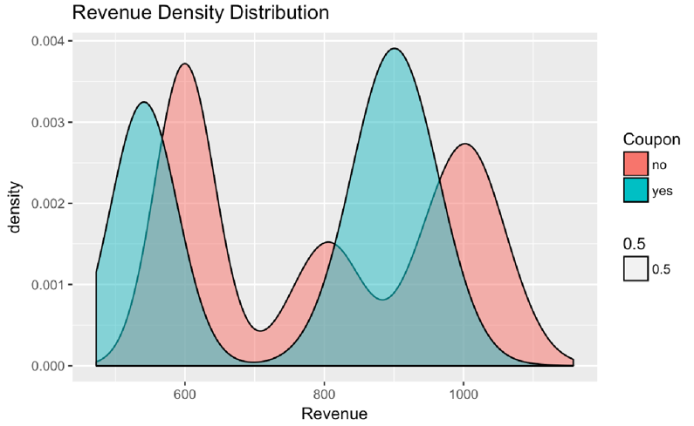
Next Steps
Guess: Coupon have different effects on tot_spending subgroups
Better segmentation
more specific,
more significant

Slide 19
Thanks for listening！

Slide 20
clustering
Coupons

Slide 21
clustering
Non-coupons

